Slide 1
Fraud Detection: Intermediate Update
Machine Learning Project
Joshua Francis and Logan Digilormo
Notes:
JOSH: Hello everyone, I'm Josh, and this is Logan. Since the proposal we have generated the data, built the features, cross-validated and tested all four models, so today we are presenting real results along with their limitations. Logan will begin with a brief recap.

Slide 2



Where we left off
The problem
The data
The plan
Flag fraudulent credit card transactions, a small share of all purchases.
Simulated transactions from the public Sparkov generator on GitHub.
Four models, tuned by time-aware cross-validation, plus PCA and t-SNE.
Notes:
LOGAN: Thanks, Josh. In the proposal we set out to detect credit card fraud using machine learning. The data is simulated with the public Sparkov generator, so no private data is involved. We planned engineered features and four models, judged by precision, recall, F1, and PR-AUC instead of accuracy. Since then we added time-aware cross-validation and dimensionality reduction. Josh will show how much of the plan is complete.

Slide 3
Progress against our proposal
Generate public data
822K transactions, 999 customers, 2025
Done
Engineer features
31 inputs; history features use past data only
Done
Cross-validated model selection
5 time-aware folds on Jan-Nov; December held out
Done
Train four models
Cross-entropy loss; precision, recall, F1, PR-AUC
Done
Dimensionality reduction
PCA, t-SNE, and models on reduced inputs
Done
Demo and final report
Scoring app built; report in progress
In progress
Notes:
JOSH: Here is our checklist against the proposal. We generated 822K transactions for 999 customers across 2025 and built 31 model inputs. We validated the models with five-fold, time-aware cross-validation on January to November and kept December as a final test. All four models are trained, and every one of them optimizes cross-entropy: logistic regression and gradient boosting minimize log loss, and the tree and forest split on entropy. We also added dimensionality reduction. The scoring demo and the final report are still ahead. Logan will walk through the data.

Slide 4

Data: generated and validated
822,484
999
1.2%
98.8%
accuracy of always guessing "not fraud". It catches zero fraud.
transactions
customers
of transactions are fraud
No private data: everything is simulated, and the generator is public and reproducible.
Notes:
LOGAN: The data has 822,484 transactions from 999 customers, with no duplicates or missing values. Fraud was surprisingly 1.2% of transactions, about 9,500 cases. That is slightly above the "under one percent" we estimated in the proposal. A model that always answers "not fraud" would therefore be 98.8% accurate and catch nothing, which is why we do not rely on accuracy. Josh will describe the features we built.

Slide 5



Features built so far
Base and category
Time
Distance
History
Amount, age, city size, and 14 category columns.
Hour, weekday, weekend flag, and night flag.
Haversine miles from home to the merchant.
9 features: gaps, speed, amount vs average, counts.
No future leakage: history features only use a customer's earlier transactions.
Notes:
JOSH: We built 31 model inputs in four groups. Base features are amount, customer age, and city size, plus fourteen merchant category columns. Time features are the hour of the day, the day of the week, and the time of day. Distance is the haversine distance from home to the merchant. History features describe each customer's past, such as the amount compared with their average and purchases in the last hour. These use only earlier transactions, so nothing leaks from the future. Logan will explain how we reduced the dimensionality of these inputs.

Slide 6
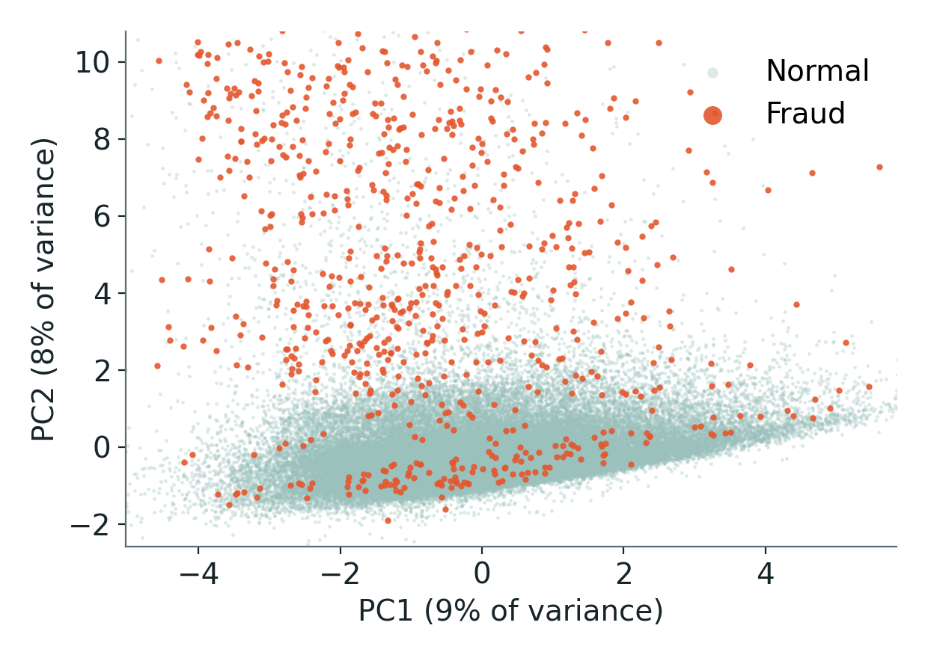

Dimensionality reduction: PCA
Share of variance explained by each component
First two components (60,000 sampled transactions)
25 of 31 components keep 95% of the variance. The first two keep 17%: PC1 tracks recent activity, PC2 tracks amount.
Notes:
LOGAN: Some of you may have heard “day of the week” and “weekend” as features and thought, “Come on, Logan and Josh! That’s a recipe for data leakage!” Our solution is dimensionality reduction. With 31 inputs that overlap, we applied PCA. It takes 25 components to keep 95 percent of the variance, and the first two keep 17 percent. The first component mostly reflects recent activity, such as purchases in the last day, and the second mostly reflects amount. In the two-dimensional view, fraud overlaps normal activity heavily, so no simple projection separates it. Josh will show a nonlinear view and the effect of reduced inputs on the models.

Slide 7
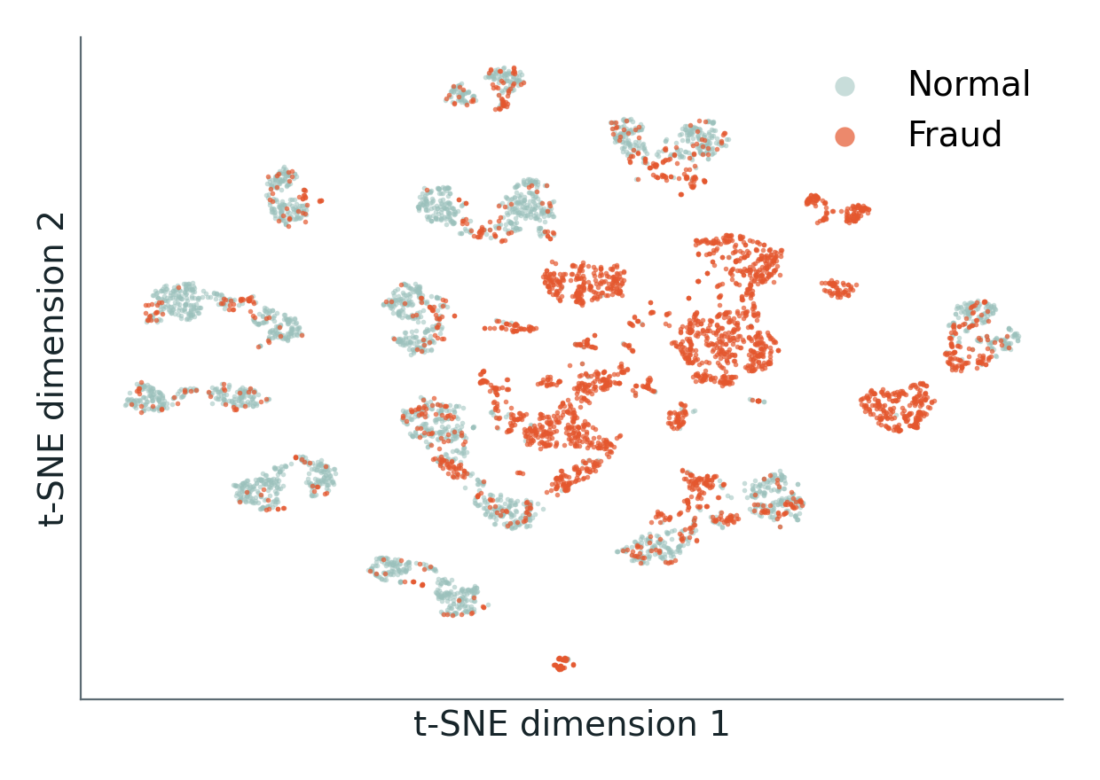

t-SNE and PCA in the models
t-SNE: 3,000 fraud and 3,000 normal transactions
Test PR-AUC with and without PCA inputs
Fraud forms local clusters (84% of a fraud point's 10 nearest neighbors are fraud). Random forest keeps 0.70 of 0.76 after PCA on continuous inputs, but only 0.004 after PCA on all 31 features.
Notes:
JOSH: To look for structure that PCA cannot show, we used t-SNE, a nonlinear method, on a balanced sample of 3,000 fraud and 3,000 normal transactions. Fraud forms local clusters: on average 84 percent of a fraud point's ten nearest neighbors are also fraud. We then trained the models on reduced inputs. PCA on only the 13 continuous features keeps most of the performance, with the random forest at 0.70 versus 0.76. PCA on all 31 features drops it to 0.004, probably because the fraud signal sits in flags and categories that the rotation mixes. We have not tested that explanation. Logan will explain how we validated the models.

Slide 8

Time-aware cross-validation
Jan 1 to Mar 14
Mar 14 to May 10
May 10 to Jun 28
Jun 28 to Aug 13
Aug 13 to Oct 5
Oct 5 to Nov 30
Test month
Fold 1
Fold 2
Fold 3
Fold 4
Fold 5
Train
Validate
Not used in this fold
Held out until the end
Mean PR-AUC across the 5 folds: random forest 0.73 ± 0.10, decision tree 0.48 ± 0.30, gradient boosting 0.56 ± 0.19.
Notes:
LOGAN: We validated with time-aware cross-validation. The January to November development period is cut into six chunks. In each of five folds, the models train on the earlier chunks and validate on the next one, so they never see the future. We chose each model's settings by average PR-AUC; that’s a measure of how much true positives occur compare to false positives, and recall, how many fraudulent transactions did each model actually catch; across the folds and its decision threshold from the pooled validation predictions. Each model was then refit on the whole development period and tested once on December. The folds also show instability: the random forest averages 0.73 with a spread of 0.10, while gradient boosting's spread is 0.19. Josh will present the early results.

Slide 9
Early model results
0.76
Test PR-AUC for the random forest. Cross-validated: 0.73 ± 0.10. Logistic regression scores 0.006.
Notes:
JOSH: Here are the four models on the held-out December test, beside their cross-validated PR-AUC. Logistic regression struggles, with an F1 of 0.04, because the fraud pattern is non-linear. The decision tree reaches 0.66, the random forest 0.72, and gradient boosting 0.30. Gradient boosting's low F1 comes from a threshold that was too strict after refitting, so its PR-AUC of 0.66 is the fairer figure. The random forest is best on both test and cross-validation. These are first-pass results with small tuning grids. Logan will cover the limitations.

Slide 10


Limitations
Simulated data
No distance signal
Fraud rate drifts
Unstable folds
Results may not transfer to real-world spending.
Single-feature score 0.50; it did not help in our first ablation.
1.3% in Jan-Nov versus 0.5% in the test month.
Small tuning grids; random forest scores vary by ±0.10 across folds.
Thresholds do not always transfer: gradient boosting reaches a PR-AUC of 0.66 but an F1 of only 0.30.
Notes:
LOGAN: We want to be clear about the limits. The data is simulated, so results may not transfer to real spending. Distance from home had no signal: its single-feature score is 0.50, a coin flip. Fraud also drifts, from 1.3% of transactions in January to November to 0.5% in the test month, and cross-validation scores vary by fold. We plan to further tinker with the model’s parameters to try to increase our PR-AUC scores. Josh will cover our scope and what has changed.

Slide 11




Scope and changes since proposal
Topic and title
Changes since proposal
Shift in emphasis
Unchanged: credit card fraud detection.
Four models, time-aware cross-validation, PCA and t-SNE, Sparkov data from GitHub.
Amount, time, and customer history lead; distance is reported honestly.
Scope: same problem and data source, with broader methods and stronger validation.
Notes:
JOSH: Our title and topic are unchanged: detecting credit card fraud with machine learning. We want to state the changes since the proposal clearly. We now use four models instead of two, a time-aware split with five-fold cross-validation, and the public Sparkov generator for data. We also added dimensionality reduction with PCA and t-SNE. Finally, the distance finding shifts our emphasis toward amount, time, and customer history. Logan will close with next steps and who is doing what.

Slide 12

Next steps and who does what
Josh
Logan
Models: Logistic regression and Decision tree
Also: Feature pipeline and the ablation study
Models: Random forest and Gradient boosting
Also: Deeper tuning and threshold choice
Together: scoring demo, final deck (Nov 22), report (Dec 6), and the GitHub repo.
Notes:
LOGAN: For next steps, Josh will be investigating logistic regression and the decision tree, along with the feature pipeline and the ablation study. I’m going to be working on the random forest and gradient boosting, including deeper tuning and threshold choice. One we finish the scoring demo, we will complete our final presentation, our report, and our GitHub repository. Thank you.

